Slide 1


Predicting Wine Quality
Dustin Syrjanen

Slide 2
Goals
Read the objective test data listed for each wine sample
01
Compare the objective test data to the subjective wine grades
02
Predict the wine grade using a classification model
03
Notes:
The goals of this project were to read the objective data listed for each wine sample and compare them to the subjective grade given to them.
Then, finally, use a classification model to predict the wine grade when given the test data

Slide 3
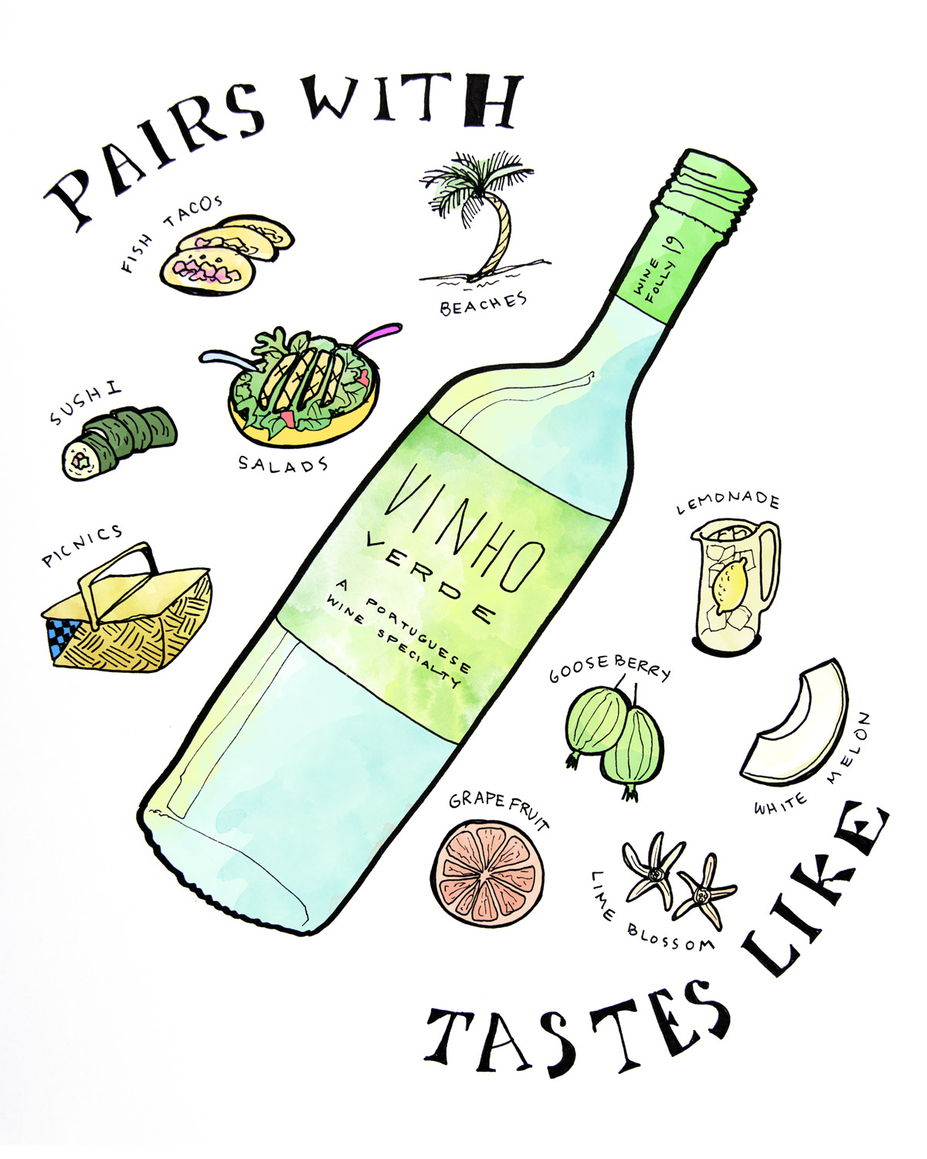
Background
Two datasets were created using red and white wine variants of the Portuguese “Vinho Verde” wine.
Vinho Verde wine comes from a small region of Northern Portugal
Known as a “super-value” wine
Vast majority are white wines
The inputs include 11 different objective attributes (alcohol, pH, etc.)
The output is the median of at least three wine experts
Quality scores are listed between 1 and 10
There are no data points listed for type of grape, brand, or price due to privacy issues
Number of Instances:
Red wine – 1,599
White wine – 4,898
Notes:
Some background on the data:
Two datasets were created using samples of red and white variants of the Portuguese “Vinho Verde” wine.
Vinho Verde comes from a small region in Northern Portugal known for its super-value whites, reds, and rosés.
There are 11 different objective attributes listed for each instance, with a subjective score between 1-10 given to each wine. These scores are the median of at least three wine expert grades.
One limitation to this data is that, due to privacy issues, there are no data points listed for type of grape, brand, or price. This may have been useful for a classification model, as there are only about 8 different grapes used in this region.
Finally, the total number of instances in each data set were roughly 1,600 red wines and 4,900 white wines

Slide 4
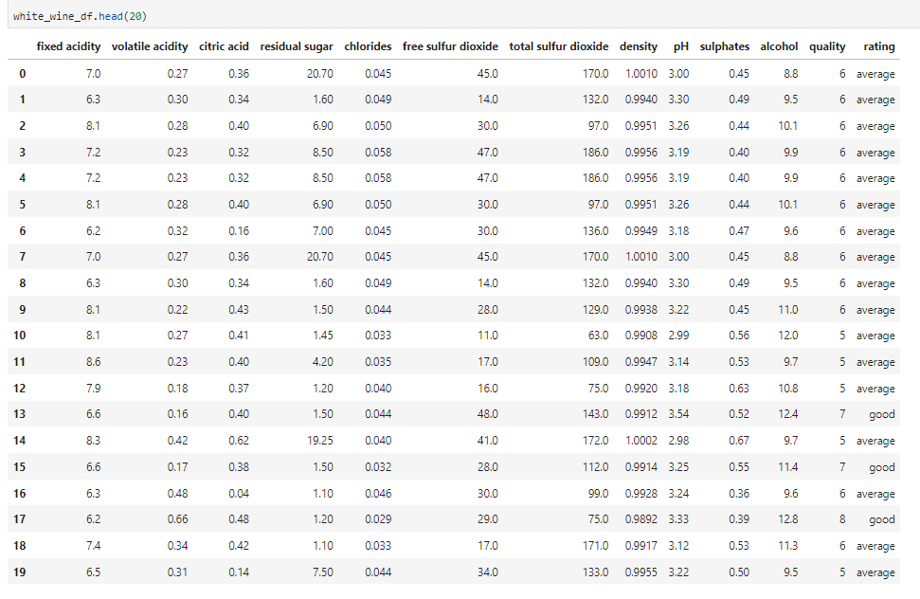
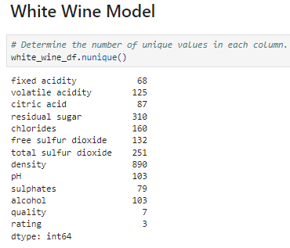
Data
Notes:
In order to make the classification model more accurate, I added the “Rating” column that splits the wine into three categories based on scores.
Scores 4 or less are labeled “Bad”, 5 and 6 are labeled “Average”, and scores 7 or above are labeled as “Good”
As you can see by the DataFrame shown and the unique values for each column, all data is numeric and there are large amounts of unique values for each attribute

Slide 5
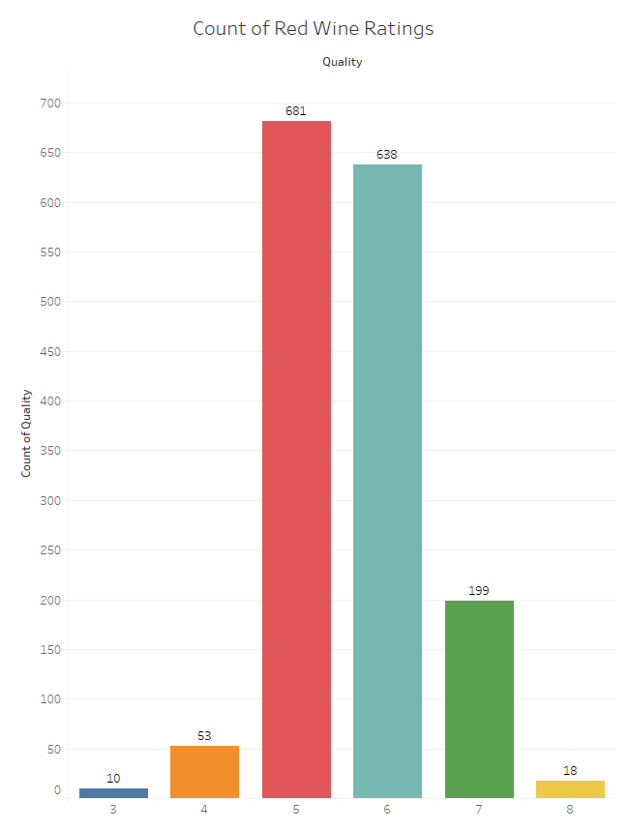
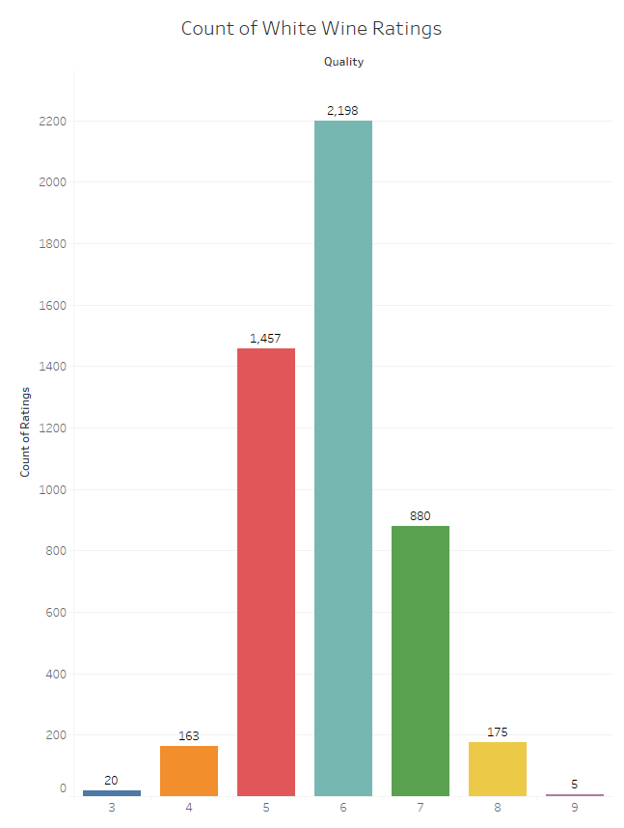
Notes:
Here are the wine ratings counts for red and white wines. As you can see, the data does create somewhat of an extreme bell curve, with a large number of wines receiving an “Average” rating.

Slide 6
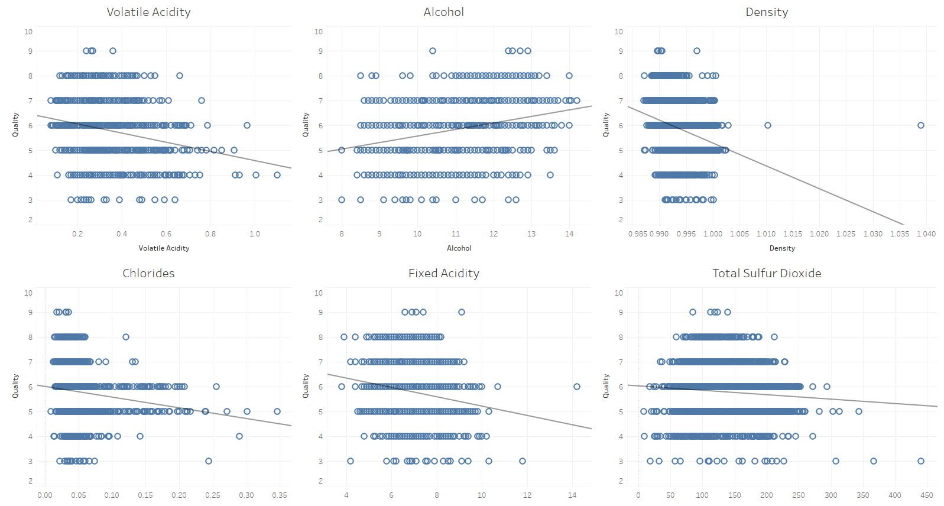
White Wine Trends
Notes:
So just to show some trends in the data, I used Tableau to chart my data and see if there were any significant trends in the data when comparing a singular characteristic to the quality
For white wines, 6 out of the 11 had a significant p-value. These were volatile acidity, alcohol, density, chlorides, fixed acidity, and total sulfur dioxide.

Slide 7
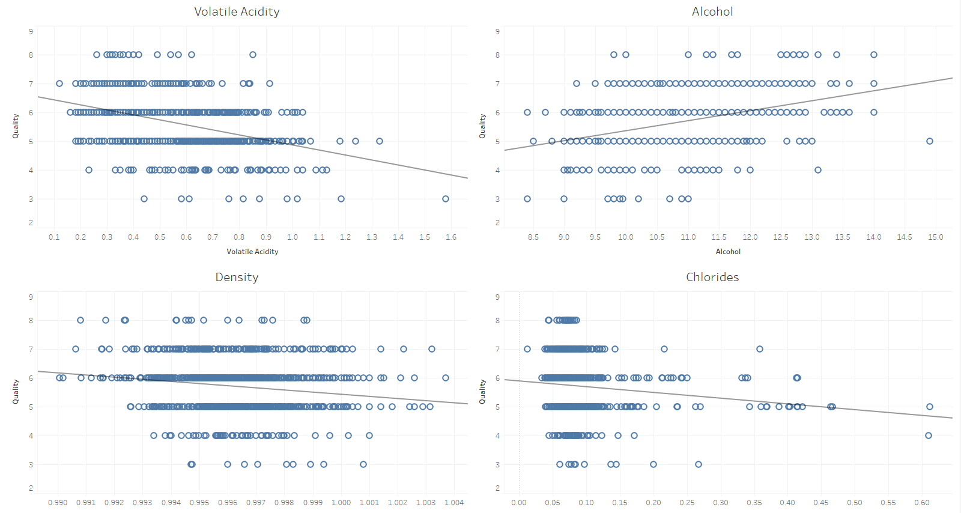
RED Wine Trends
Notes:
When looking at the red wine trends the first four characteristics from the white wine are also shown to have a significant correlation with quality, with fixed acidity and total sulfur dioxide dropping off

Slide 8
White Wine Model
 | Precision | Recall | f1-score | Support
Average | 0.84 | 0.89 | 0.86 | 917
Bad | 0.38 | 0.15 | 0.21 | 41
Good | 0.61 | 0.54 | 0.58 | 267
Accuracy |  |  | 0.79 | 1225
Macro Avg | 0.61 | 0.53 | 0.55 | 1225
Weighted Avg | 0.77 | 0.79 | 0.78 | 1225
Notes:
For the white wine model, I used three hidden layers with 50, 50, and 25 neurons, respectively, trained with ReLU. The output layer had a sigmoid activation function.
This resulted in an overall accuracy of 79%, which was above my goal of 75%. However, the bad and good ratings weren’t quite as accurate. This is likely due to there not being as many instances of good or bad ratings when compared to the average rating.

Slide 9
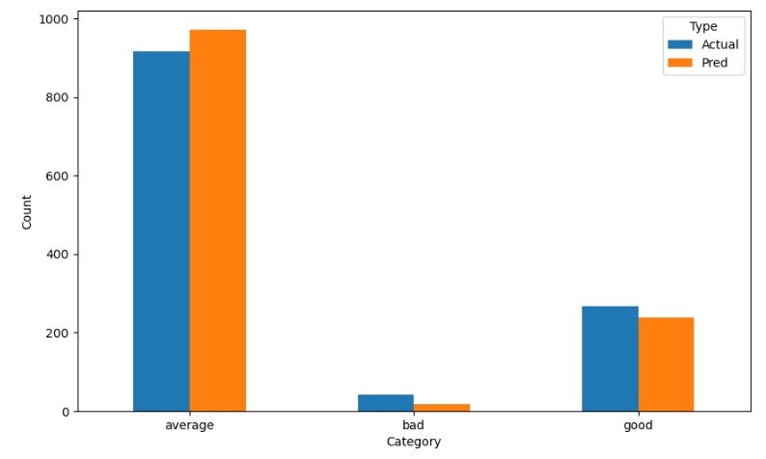
White Wine Model
Notes:
When comparing the count of actual to predicted ratings, the model looks pretty good

Slide 10
Red Wine Model
 | Precision | Recall | f1-score | Support
Average | 0.89 | 0.93 | 0.91 | 336
Bad | 0.25 | 0.06 | 0.10 | 17
Good | 0.51 | 0.49 | 0.50 | 47
Accuracy |  |  | 0.84 | 400
Macro Avg | 0.55 | 0.49 | 0.50 | 400
Weighted Avg | 0.82 | 0.84 | 0.83 | 400
Notes:
For the red wine model, I used three hidden layers with 20, 20, and 10 neurons, respectively, again using ReLU and a sigmoid activation for the output layer.
This resulted in an overall accuracy of 84%, which again beat my goal of 75%.
The bad and good accuracies were lower than the white wine model, but the red wine had even fewer instances in these categories and the bad had a sample size less than 30

Slide 11
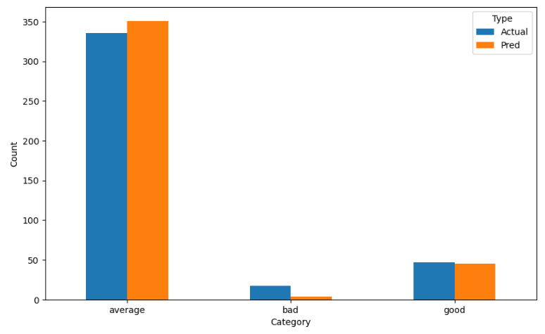
Red Wine Model
Notes:
When you look at the comparison again, the model doesn’t look too bad with the counts of actual vs predicted

Slide 12
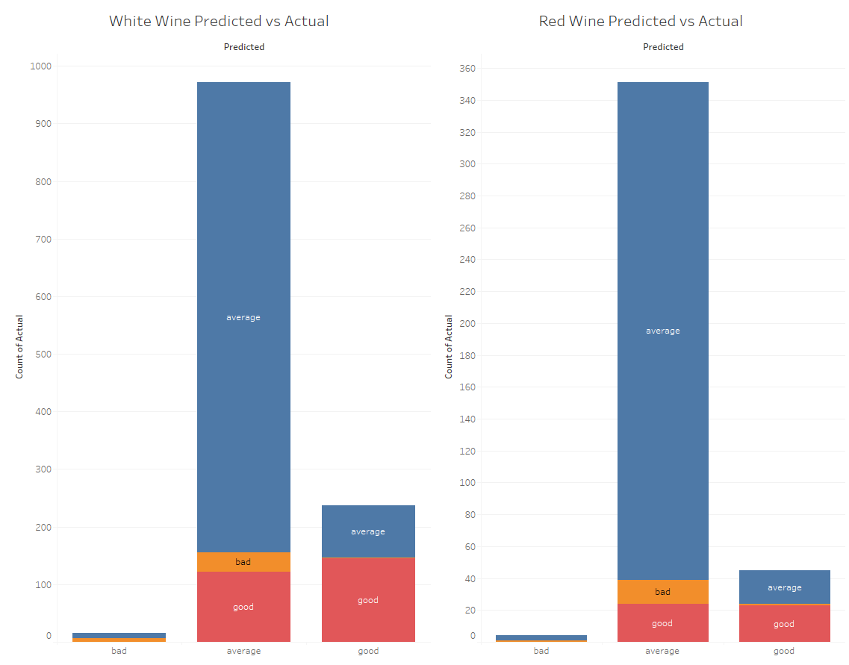
Predicted vs Actual
Notes:
This final chart shows the actual totals of each category, with the colors showing what the models predicted for each category
As you can see, it did very well with average scores, but was about 50% accurate with good and the least accurate with bad scores, putting many of them in the average category
However, it is nice to see that only two total “bad” ratings were predicted to be “good”, and there were no “good” scores that were predicted to be “bad”

Slide 13
Conclusions
Both data models exceeded the goal of 75% accuracy
Red wine 84%, White wine 79%
The models were very good at predicting “Average” ratings
Not as efficient with “Good” and “Bad” ratings
Limitations:
No data on grape types
Low number of “Good” and “Bad” ratings
Unsure if all input variables are relevant
Interested to test feature selection methods to lower the complexity of the model
Notes:
Some conclusions I got from doing this project:
Both data models exceeded the goal of 75% accuracy: Red wine 84%, White wine 79%
The models were very good at predicting “Average” ratings, but not as efficient with “Good” and “Bad” ratings
Some limitations I ran into: No data on grape types, which may have helped with the classification model
Low number of “Good” and “Bad” ratings
Unsure if all input variables are relevant
Interested to test feature selection methods to lower the complexity of the model

Slide 14
Citations
P. Cortez, A. Cerdeira, F. Almeida, T. Matos and J. Reis. Modeling wine preferences by data mining from physicochemical properties. In Decision Support Systems, Elsevier, 47(4):547-553. ISSN: 0167-9236.
Red Wine Quality, https://www.kaggle.com/datasets/uciml/red-wine-quality-cortez-et-al-2009
Beginner’s Guide To Vinho Verde Wine, https://winefolly.com/deep-dive/vinho-verde-the-perfect-poolside-wine-from-portugal/
GitHub: https://github.com/dsyrjanen/wine-reviews

